Slide 1
DARAZ.pk STQA PROJECT

Slide 2
Title Slide
Testing & Quality Assurance of Daraz E‑Commerce Application
Course: Software Testing & Quality Assurance
Department: BS Information Technology
University of Layyah
Instructor: Faisal Hafeez

Slide 3
Team Members
Test Lead & Manual Tester : M Ayaz
Automation Tester : M Shahroz Ali
API Tester : M Hamza Younis
Defect Manager & Documentation : M Kamran

Slide 4
Introduction
Daraz is a web‑based e‑commerce platform
Provides online shopping services
This project focuses on testing, not development

Slide 5
Project Objective
Apply STQA concepts in real‑world application
Perform manual, automation & API testing
Identify and manage defects
Ensure software quality

Slide 6
Project Scope
Functional Testing
Automation Testing
API Testing
Defect Management
QA Documentation

Slide 7
Selected System
Application Type: Web‑based E‑commerce
Application Name: Daraz
Reason for selection: Real‑world system

Slide 8
Manual Tester Responsibilities
Test case design
Test execution
UI & functional testing
Bug identification

Slide 9
Automation Tester Responsibilities
Automate critical test cases
Regression testing
Reduce manual effort

Slide 10
API Tester Responsibilities
Backend API testing
Request & response validation
Status code verification

Slide 11
Manual Testing Overview
25+ manual test cases
Functional & negative testing
Modules tested: Login, Search, Cart, Checkout

Slide 12
Sample Manual Test Case
Login with valid credentials
Expected: Successful login
Actual: User logged in
Status: Pass

Slide 13
Automation Testing Overview
Tool: Selenium WebDriver
8 automated test cases
Focus on repetitive scenarios

Slide 14
Automated Scenarios
Home page
Product Search
Invalid Search
Search with special Characters

Slide 15
API Testing Overview
Tool: Postman
8 API test cases
GET & POST methods used

Slide 16
API Testing Examples
Search
Add to Cart
Status Code 200 400

Slide 17
Bug Reporting & Defect Management
Tool: Jira (simulated)
7 defects logged
Severity & priority assigned

Slide 18
Defect Life Cycle
New → Assigned → Open → Fixed → Retest → Closed

Slide 19
Test Summary & Results
Manual Test Cases: 25
Automation Test Cases: 8
API Test Cases: 8
Overall system stable

Slide 20
Conclusion & Future Scope
Quality improved through testing
Defects identified & resolved
Performance testing
Security testing

Slide 21
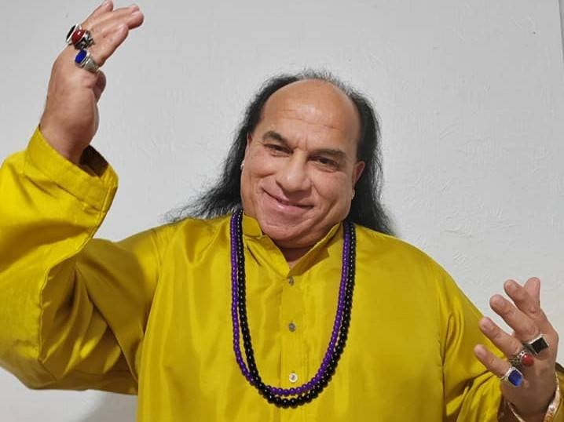
HOR KOI SADY LAIK HUKAM!

